Slide 1
Computer Organization Principles
School of Software, Dalian University of Technology
Chi Lin (林驰)
chilin@mail.dlut.edu.cn

Slide 2
Chapter 3 Representing & Manipulating Information
Contents
Data Representation & Encoding
Integer Representations
Integer Arithmetic
Floating Point
Arithmetic Logical Unit (ALU)

Slide 3
Integer Arithmetic
Addition
Multiplication
Division

Slide 4
Negation: Complement & Increment
Claim: Following Holds for 2’s Complement
~x + 1 == -x
Complement
Observation: ~x + x == 1111…111 == -1
Complete Proof?
x
1
0
0
1
1
1
0
1
+
~x
0
1
1
0
0
0
1
0
-1
1
1
1
1
1
1
1
1

Slide 5
Complement & Increment Examples
x = 15213
x = 0

Slide 6
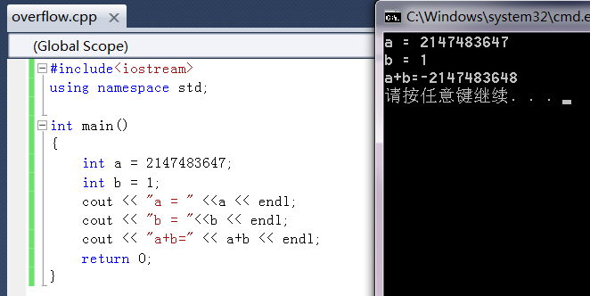

Surprising & Astonishing Results

Slide 7



Unsigned Addition
Two w-bit unsigned numbers: x, y
Overflow may happen, w-bit will not be enough.
E.g. w=4
2+3=[0010]+[0011]=[0101]=5 (Enough)
8+9=[1000]+[1001]=[10001]=17 (5 bits are required)
$$0≤x≤2^{w}−1$$
$$0≤y≤2^{w}−1$$
w+1 bits are needed
$$0≤x+y≤2^{w+1}−2$$

Slide 8
Unsigned Addition
u
Operands: w bits
• • •
+
v
• • •
True Sum: w+1 bits
u + v
• • •
Discard Carry: w bits
UAdd_{w}(u , v)
• • •
Standard Addition Function
Ignores carry output
Implements Modular Arithmetic
s = UAdd_{w}(u , v) = u + v mod 2^{w}

Slide 9
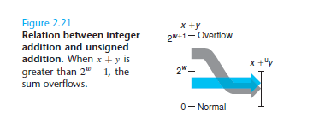
Unsigned Addition Overflow
How to solve the overflow problem ?
MSB will be truncated.

Slide 10
Visualizing (Mathematical) Integer Addition
Integer Addition
4-bit integers u, v
Compute true sum Add₄(u , v)
Values increase linearly with u and v
Forms planar surface
Add₄(u , v)
v
u

Slide 11

Use the following equation to solve the overflow problem
Although the overflow is resolved, sometimes, the precision will be destroyed……
Try to think out a method to check whether an overflow happened using C language.

Slide 12
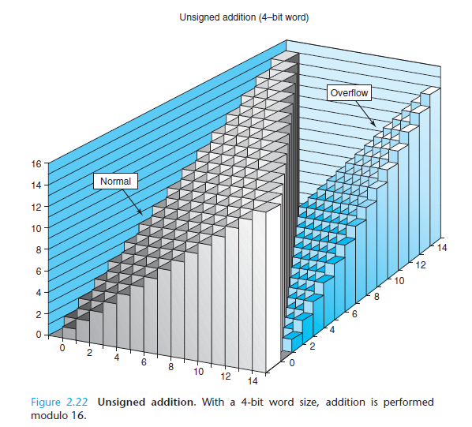
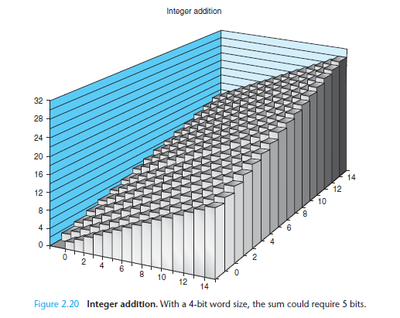
Unsigned Addition

Slide 13
Visualizing Unsigned Addition
Wraps Around
If true sum ≥ 2^{w}
At most once
Overflow
UAdd₄(u , v)
True Sum
2^{w+1}
Overflow
2^{w}
v
0
Modular Sum
u

Slide 14
Mathematical Properties
Modular Addition Forms an Abelian Group
Closed under addition
0 ≤ UAdd_{w}(u , v) ≤ 2^{w} –1
Commutative
UAdd_{w}(u , v) = UAdd_{w}(v , u)
Associative
UAdd_{w}(t, UAdd_{w}(u , v)) = UAdd_{w}(UAdd_{w}(t, u ), v)
0 is additive identity
UAdd_{w}(u , 0) = u
Every element has additive inverse
Let UComp_{w} (u ) = 2^{w} – u UAdd_{w}(u , UComp_{w} (u )) = 0

Slide 15



Two’s Com Addition
Two w-bit Two’s Com numbers: x, y
Overflow may happen, w-bit will not be enough.
E.g. w=4
2+3=[0010]+[0011]=[0101]=5 (Enough)
8+9=[1000]+[1001]=[10001]=17 (5 bits are required)
$$−2^{w−1}≤x≤2^{w−1}−1$$
$$−2^{w−1}≤y≤2^{w−1}−1$$
w+1 bits are needed
$$−2^{w}≤x+y≤2^{w}−2$$

Slide 16
Two’s Complement Addition
Operands: w bits
u
• • •
+
v
• • •
True Sum: w+1 bits
u + v
• • •
Discard Carry: w bits
TAdd_{w}(u , v)
• • •
TAdd and UAdd have Identical Bit-Level Behavior
Signed vs. unsigned addition in C:
int s, t, u, v;
s = (int) ((unsigned) u + (unsigned) v);
t = u + v
Will give s == t

Slide 17
TAdd Overflow
Functionality
True sum requires w+1 bits
Drop off MSB
Treat remaining bits as 2’s comp. integer
True Sum
0 111…1
2^{w}–1
PosOver
TAdd Result
0 100…0
2^{w –1}-1
011…1
0 000…0
0
000…0
1 011…1
–2^{w –1}
100…0
1 000…0
–2^{w}
NegOver

Slide 18
Visualizing 2’s Complement Addition
NegOver
Values
4-bit two’s comp.
Range from -8 to +7
Wraps Around
If sum ≥ 2^{w–1}
Becomes negative
At most once
If sum < –2^{w–1}
Becomes positive
At most once
TAdd₄(u , v)
v
u
PosOver

Slide 19
Example of Two’s Com Overflow
6+7=[0110]+[0111]=[1101]=>Two’s Com [1101]=-3
-6+-7=[1010]+[1001]=[10011]=>Two’s [0011]=3

Slide 20
Characterizing TAdd
Positive Overflow
Functionality
True sum requires w+1 bits
Drop off MSB
Treat remaining bits as 2’s comp. integer
TAdd(u , v)
> 0
v
< 0
< 0
> 0
u
Negative Overflow
2^{w}
(NegOver)
2^{w}
(PosOver)

Slide 21
Mathematical Properties of TAdd
Isomorphic Group to unsigneds with UAdd
TAdd_{w}(u , v) = U2T(UAdd_{w}(T2U(u ), T2U(v)))
both have identical bit patterns
Two’s Complement Under TAdd Forms a Group
Closed, Commutative, Associative, 0 is additive identity
Every element has additive inverse

Slide 22
Multiplication (Unsigned & Two’s Com)
Computing Exact Product of w-bit numbers x, y
Either signed or unsigned
Ranges
Unsigned: 0 ≤ x * y ≤ (2^{w} – 1) ² = 2^{2w} – 2^{w+1} + 1
Up to 2w bits
Two’s complement min: x * y ≥ (–2^{w–1})*(2^{w–1}–1) = –2^{2w–2} + 2^{w–1}
Up to 2w–1 bits
Two’s complement max: x * y ≤ (–2^{w–1}) ² = 2^{2w–2}
Up to 2w bits, but only for (TMin_{w})²

Slide 23
Multiplication
Maintaining Exact Results
Would need to keep expanding word size with each product computed
Done in software by “arbitrary precision” arithmetic packages

Slide 24
Unsigned Multiplication in C
u
• • •
Operands: w bits
*
v
• • •
True Product: 2*w bits
u · v
• • •
• • •
UMult_{w}(u , v)
Discard w bits: w bits
• • •
Standard Multiplication Function
Ignores high order w bits
Implements Modular Arithmetic
UMult_{w}(u , v) = u · v mod 2^{w}

Slide 25
Example of Unsigned Multiplication
8*9=[1000]*[1001]=[1001000]=[1000]=8
15*15=[1111]*[1111]=[11100001]=[0001]=1

Slide 26
Signed Multiplication in C
u
• • •
Operands: w bits
*
v
• • •
True Product: 2*w bits
u · v
• • •
• • •
TMult_{w}(u , v)
Discard w bits: w bits
• • •
Standard Multiplication Function
Ignores high order w bits
Some of which are different for signed vs. unsigned multiplication (Next slice)
Lower bits are the same

Slide 27
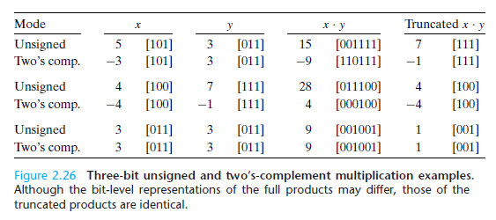
Example of Signed Multiplication

Slide 28
Power-of-2 Multiply with Shift
Operation
u << k gives u * 2^{k}
Both signed and unsigned
Examples
u << 3 == u * 8
u << 5 - u << 3 == u * 24
Most machines shift and add faster than multiply
Compiler generates this code automatically
k
u
• • •
Operands: w bits
*
2^{k}
0
•••
0
1
0
•••
0
0
True Product: w+k bits
u · 2^{k}
• • •
0
•••
0
0
Discard k bits: w bits
UMult_{w}(u , 2^{k})
•••
0
•••
0
0
TMult_{w}(u , 2^{k})

Slide 29
Example
Integer Multiplication instructions require 10 or more clock cycles.
E.g. 29*x
Optimization 1: Change into shifting & addition
E.g. 29=16+8+4+1=(x<<4)+(x<<3)+(x<<2)+x (3 shifts, 3 addition operations)
Optimization 2
E.g. 29=32-2-1=(x<<5)+-(x<<1)+-x (2 shifts, 2 addition operations )

Slide 30
Unsigned Power-of-2 Divide with Shift
Quotient (商) of Unsigned by Power of 2
u >> k gives ⎣ u / 2^{k} ⎦
Uses logical shift
k
u
•••
•••
Binary Point
Operands:
/
2^{k}
0
•••
0
1
0
•••
0
0
Division:
u / 2^{k}
0
.
0
•••
0
0
•••
•••
Result:
⎣ u / 2^{k} ⎦
0
0
•••
0
0
•••

Slide 31
Signed Power-of-2 Divide with Shift
Quotient of Signed by Power of 2
x >> k gives ⎣ x / 2^{k} ⎦
Uses arithmetic shift
Rounds wrong direction when u < 0
k
x
•••
•••
Binary Point
Operands:
/
2^{k}
0
•••
0
1
0
•••
0
0
Division:
x / 2^{k}
0
•••
•••
.
•••
Result:
RoundDown(x / 2^{k})
0
•••
•••

Slide 32
Properties of Unsigned Arithmetic
Unsigned Multiplication with Addition Forms Commutative Ring
Addition is commutative group
Closed under multiplication
0 ≤ UMult_{w}(u , v) ≤ 2^{w} –1
Multiplication Commutative (交换律)
UMult_{w}(u , v) = UMult_{w}(v , u)

Slide 33
Properties of Unsigned Arithmetic
Multiplication is Associative (结合律)
UMult_{w}(t, UMult_{w}(u , v)) = UMult_{w}(UMult_{w}(t, u ), v)
1 is multiplicative identity(乘法单位)
UMult_{w}(u , 1) = u
Multiplication distributes over addition (分配律)
UMult_{w}(t, UAdd_{w}(u , v)) = UAdd_{w}(UMult_{w}(t, u ), UMult_{w}(t, v))

Slide 34
Properties of Two’s Comp. Arithmetic
Isomorphic Algebras (同构代数)
Unsigned multiplication and addition
Truncating to w bits
Two’s complement multiplication and addition
Truncating to w bits
Both Form Rings
Isomorphic to ring of integers mod 2^{w}

Slide 35
Properties of Two’s Comp. Arithmetic
Comparison to (Mathematical) Integer Arithmetic
Both are rings
Integers obey ordering properties, e.g.,
u > 0 ⇒ u + v > v
u > 0, v > 0 ⇒ u · v > 0
These properties are not obeyed by two’s comp. arithmetic
TMax + 1 == TMin
15213 * 30426 == -10030 (16-bit words)

Slide 36
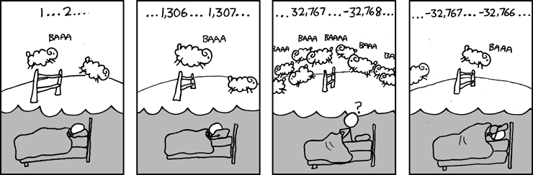
Aha！Gotcha
Example 1:
40000 * 40000 = 1600000000
50000 * 50000 = ??
Example 2: Is (x + y) + z = x + (y + z)?

Slide 37
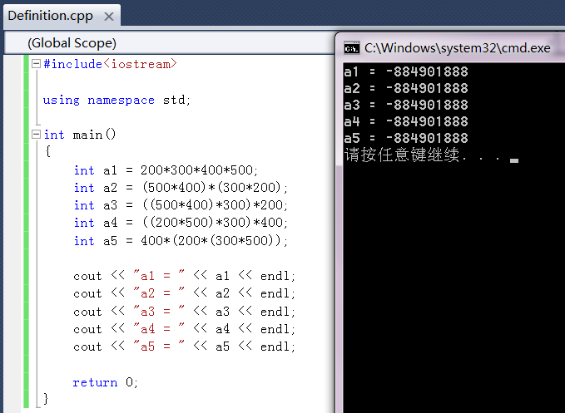
Aha！Gotcha

Slide 38
Homework
Practice Problem 2.28
Practice Problem 2.34
Practice Problem 2.40
Practice Problem 2.44

Slide 39
Thank You

